Slide 1

Turkey House Sales
Data Analysis
Road Runner
December 2019

Slide 2
What we have as source data?
House sales Provinced based
Year;Month;Province;Mortgaged_FirstHand_Sale;
Mortgaged_SecondHand_Sale;Other_FirstHand_Sale;
Other_SecondHand_Sale
House Sales Foreigners
Year,Province, sales counts per month
House Sales Gender
Year,City,Female,Male,
Common,Other,Total
House Sales by Nationalities
Year,Country,
counts per Months

Slide 3


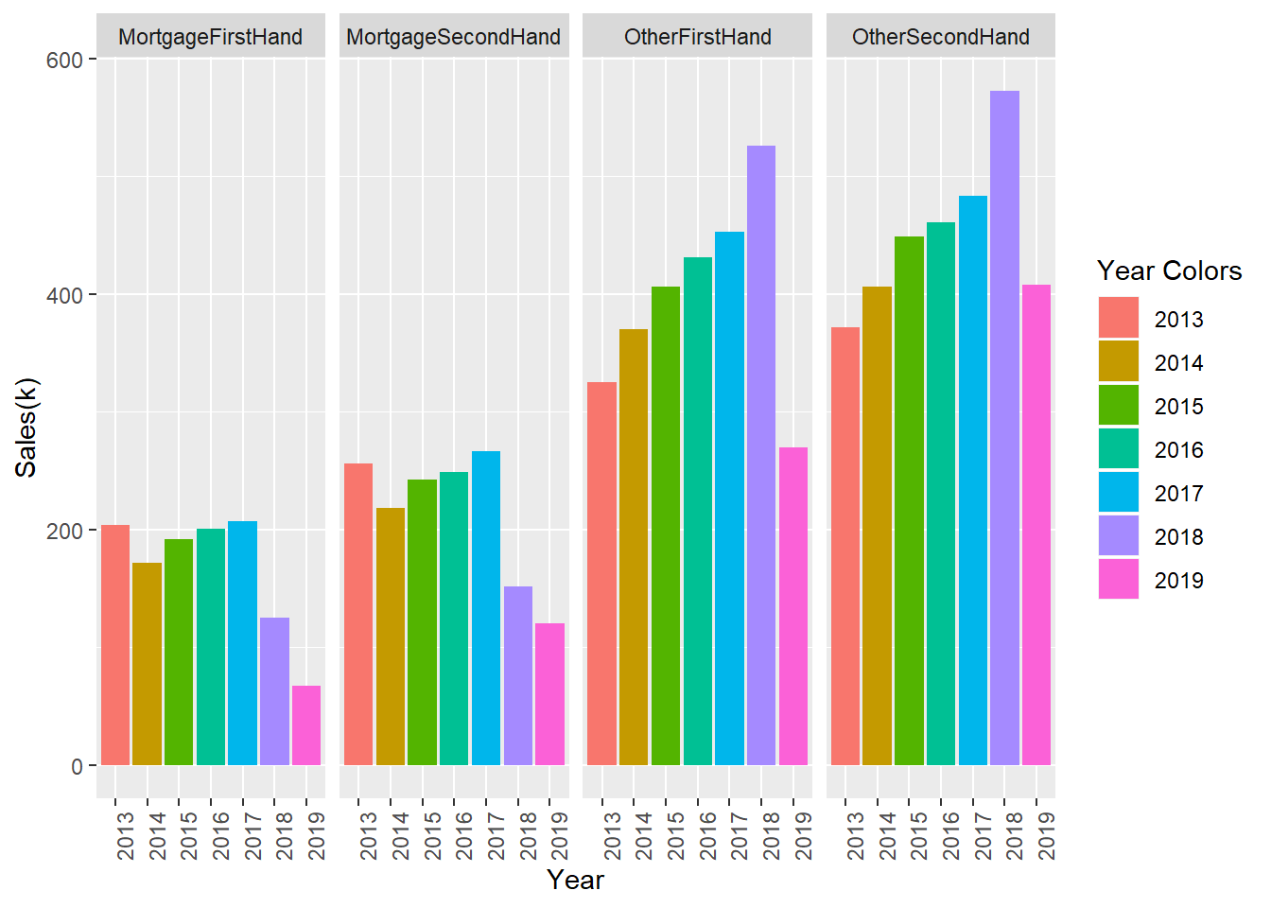
5932005
5932005
Total Sales Numbers through Years by Sales Type between years 2013-2019
The sales payment type distribution
M
O
2.671.524
Mortgaged sales
summary
5.932.005
Other payment Sales
Summary
31,1 % of total sales made through
mortgage system

Slide 4
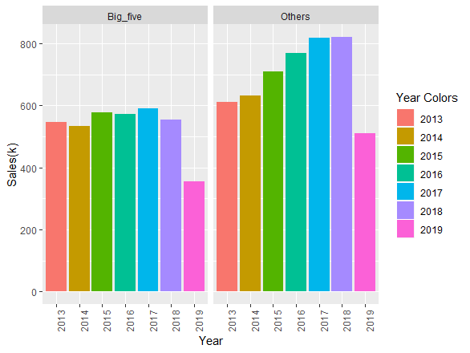
Total Sales Numbers Comparising Five most populated Cities and the Others
B
O
3729838
House sales in
Big Cities
1389747
House sales in Other cities
*Istanbul, Ankara, Izmir, Bursa, Antalya

Slide 5
House Sales to by gender between 2014 and 2018
An interesting point here is, house sales to males from 2017 through 2018 is decreasing,
altough sales to female in same period is increasing.

Slide 6
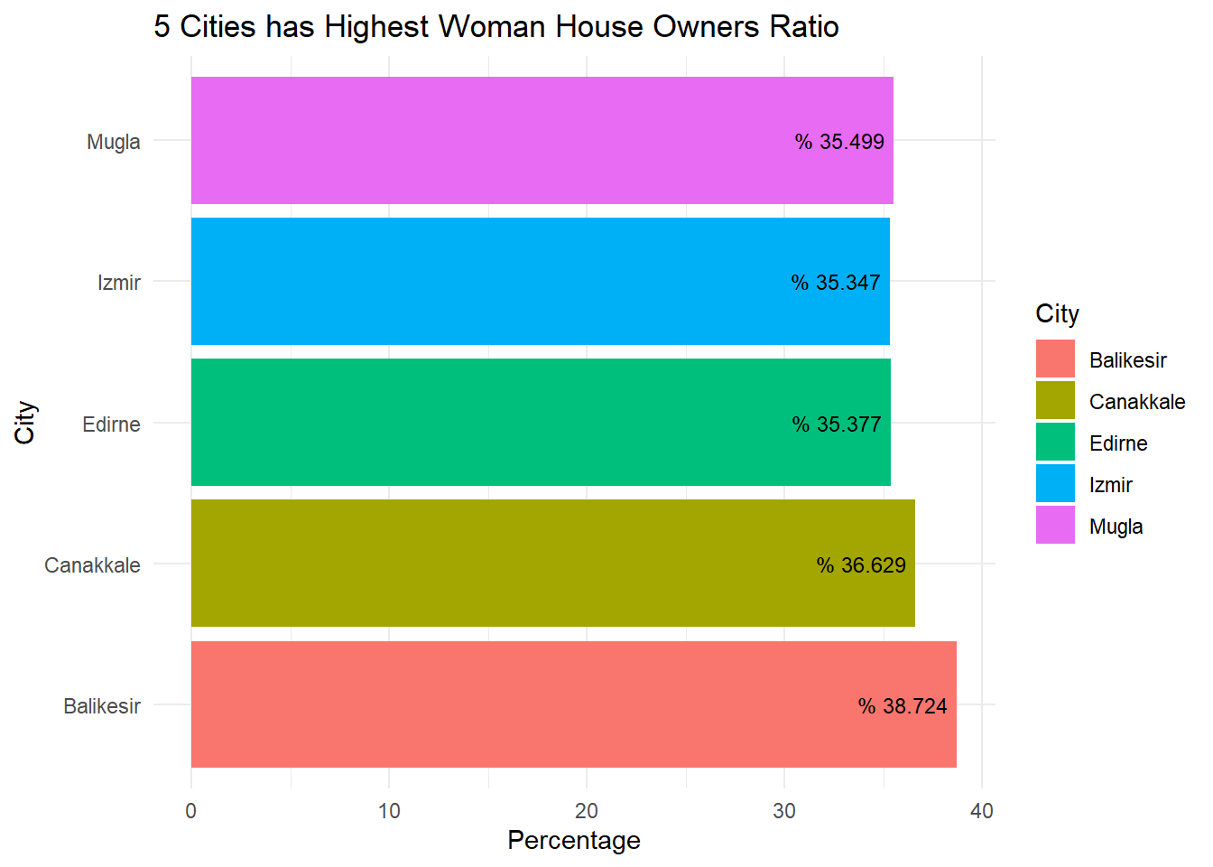
$ pink dollars
Balıkesir take the lead for female owners ratio among other cities while Canakkale follows.
Ege, Marmara and Akdeniz are the regions
has highest female house owner ratio.

Slide 7

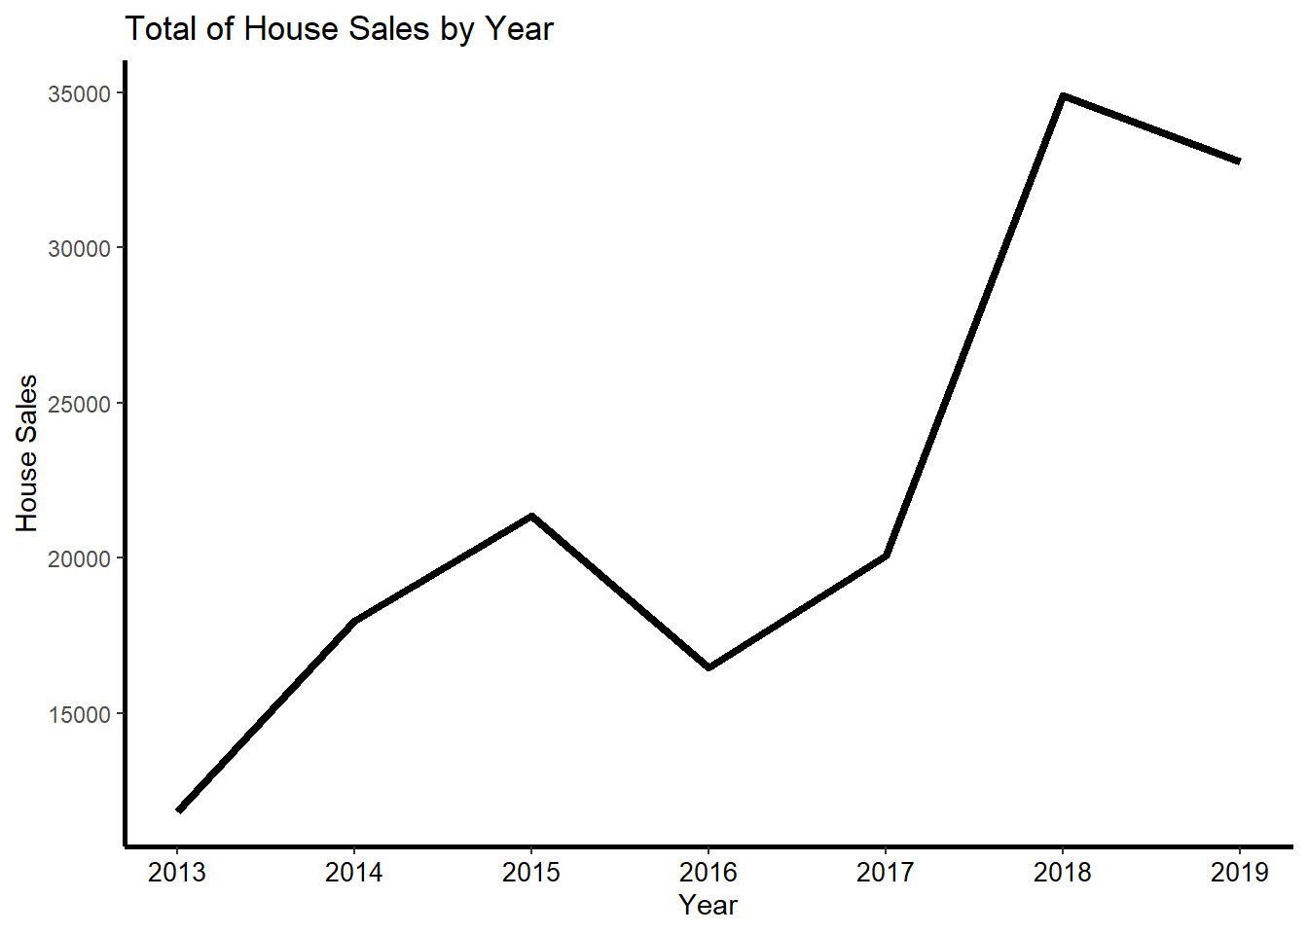
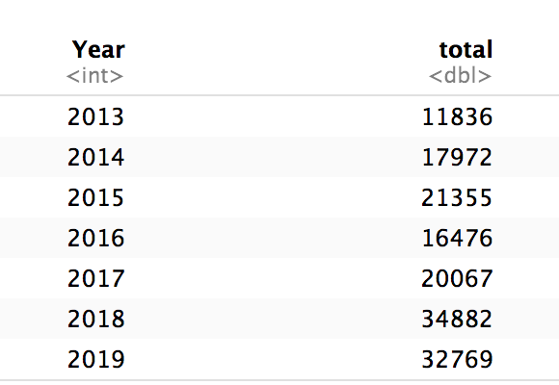
House Sales to foreigners per year
House sales to foreigners between 2017 and 2018 is
remarkable increased. Since 2019 November and December
sales could not be reflected into this analysis,
the change between 2018 and 2019 could not be determined.

Slide 8
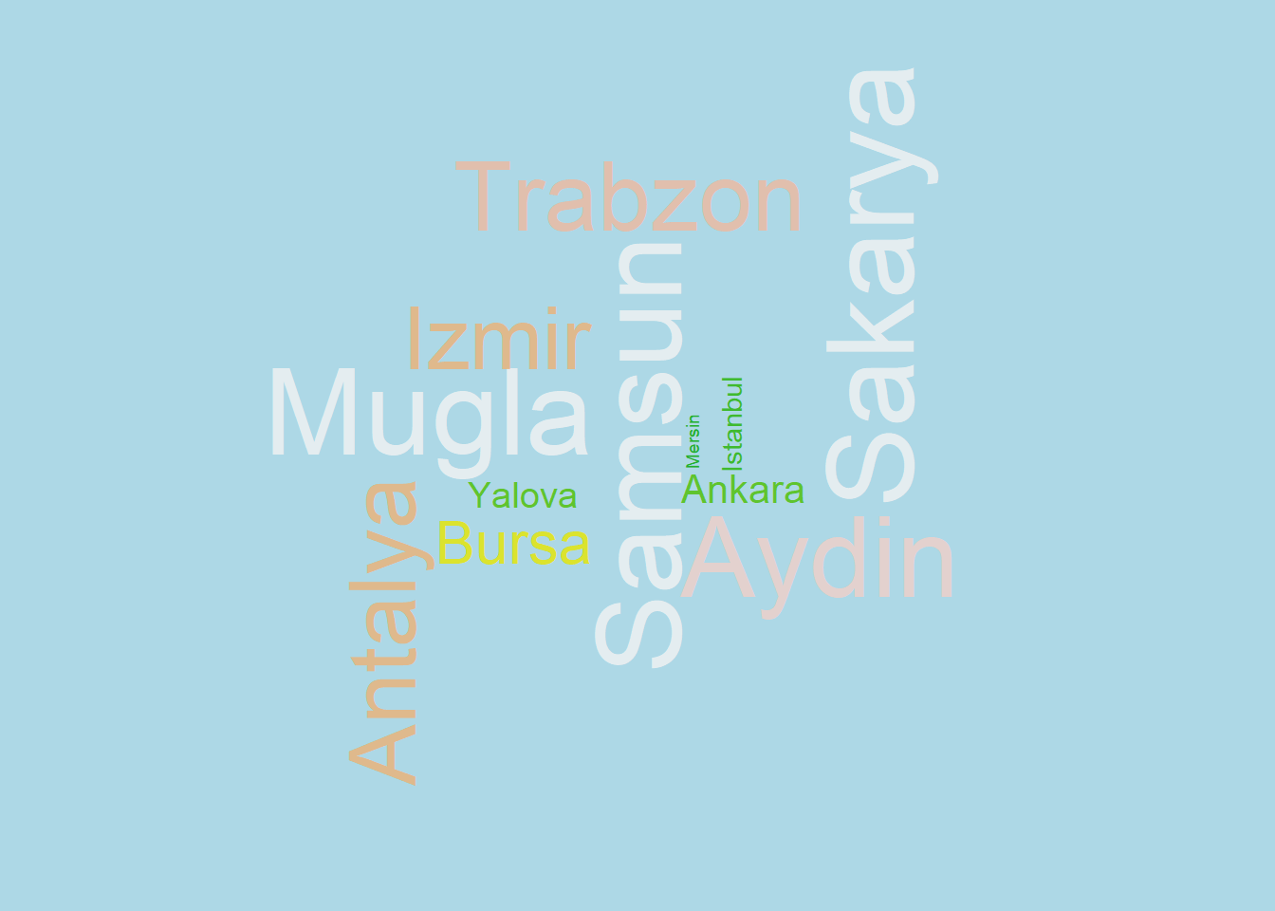
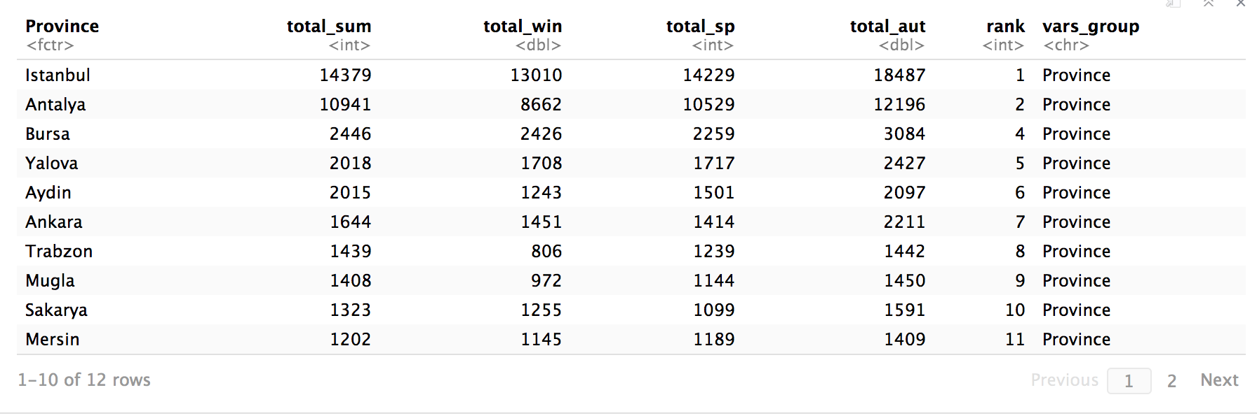
Sales numbers to foreigners are
analyzed for several cities.
We examine the sales up to seasons as well.

Slide 9
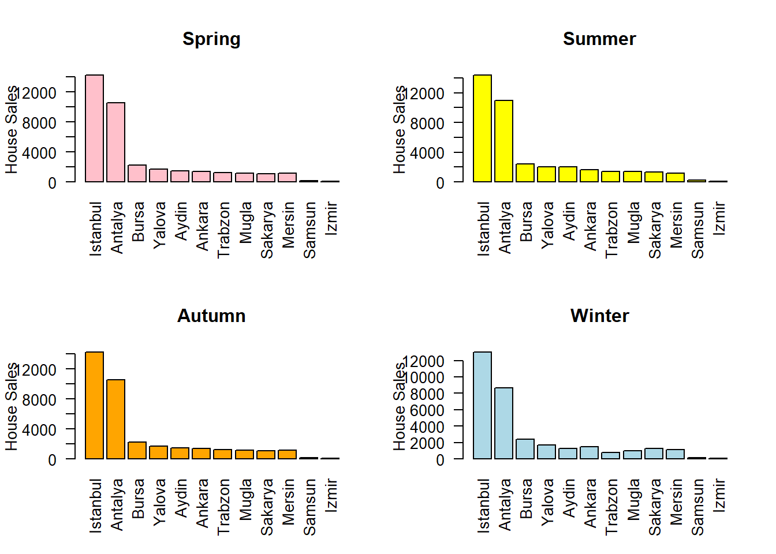
Does the sales amount change by season ?
This plot states that seasons doesn't have significant impact on house sales.

Slide 10
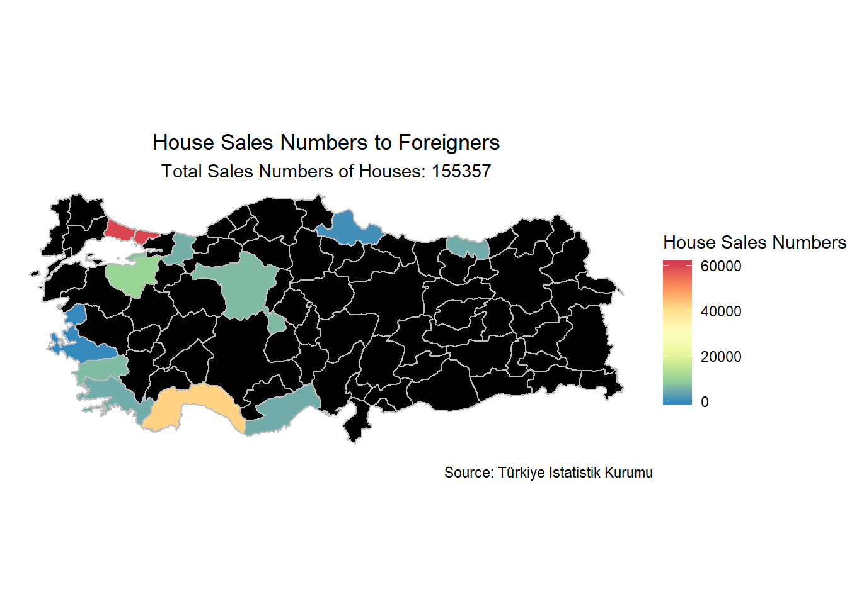
And we can see the distribution over Turkey map
1.Istanbul
2.Antalya
..
10.İzmir
11.Samsun
Istanbul has the highest sales density while Antalya follows.
Although Samsun and Izmir have the lowest sales density

Slide 11

Total Sales Numbers per country since 2015
The countries whose total sales is more than 5k
Iraq
25.398
Saudi Arabia
12.493
Iran
10.012
Kuwait
9.385
Russia
9.119
Afghanistan6.686
Germany
5.643
United Kingdom
5.026

Slide 12

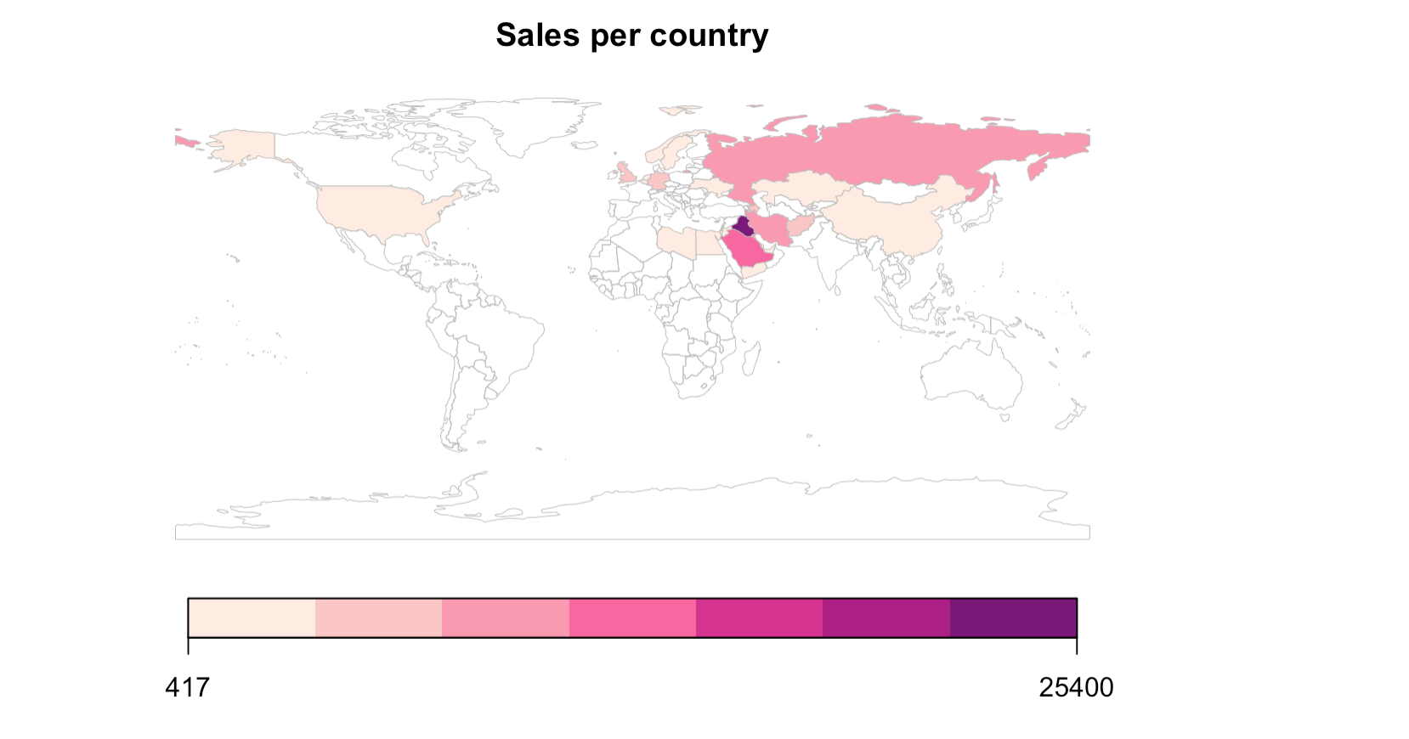

Slide 13


Thank you for listening
Emre Usta
Erkan Tekingül
Tuğçe Aydın
Bilgehan Kıran Çelebi
Gökhan Koca

